Slide 1
One Swipe WhiteBoard Eraser
By Bach, Jorge, Spencer, Kuber
“PMNP”

Slide 2
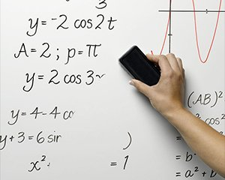
Current Whiteboard Eraser
Time Consuming
Untidy Erasing
Need Lots of Manual Effort

Slide 3
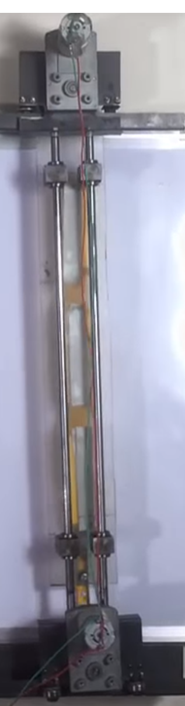

Inspiration
Nevon project - Automated Whiteboard
https://youtu.be/bvh4y4ZNDPU?t=5s
connecting rods, couple of wheels,
brackets, plates, motors,
Pins, dusters, wire.

Slide 4
Problem Statement
Our goal is to design and prototype a practical and inexpensive mechanism that reduces the amount of work needed to fully erase a whiteboard.

Slide 5
Focus
  Efficient Mechanical Aspect
  Affordable
  Uninvolved

Slide 6
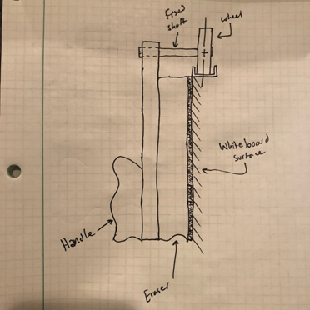
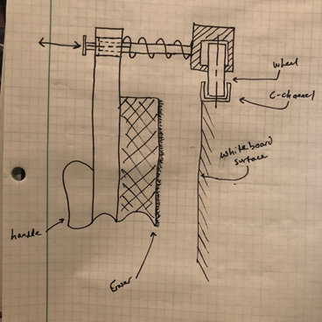
Pre-Assembly
Design Ideas:
Figure 1: Our first design, with the shafts being fixed to the handle
Figure 2: Our second design, the introduction to the spring-loaded brackets

Slide 7
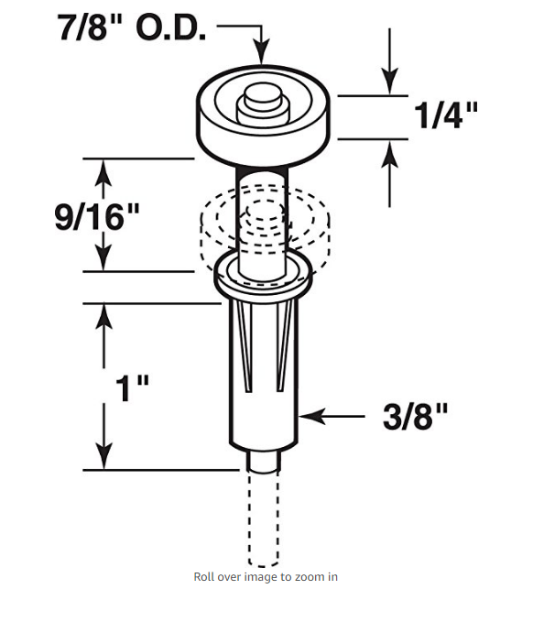
Design of the Wheel
Inspiration: Bi-fold door wheel design on Amazon
sfasd
We decided to improve from this model to fit in a bearing as well as reducing the width of the wheel to use on ¼’ C-beam.
We used tape on the end of pin to constrain the wheel from sliding along the pin.

Slide 8
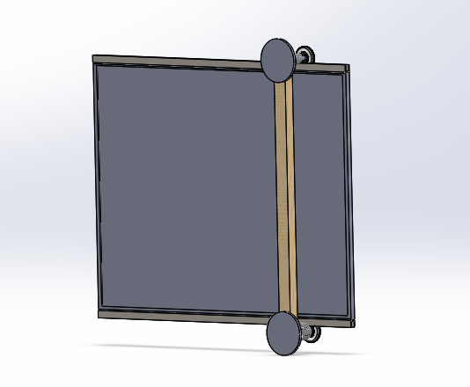
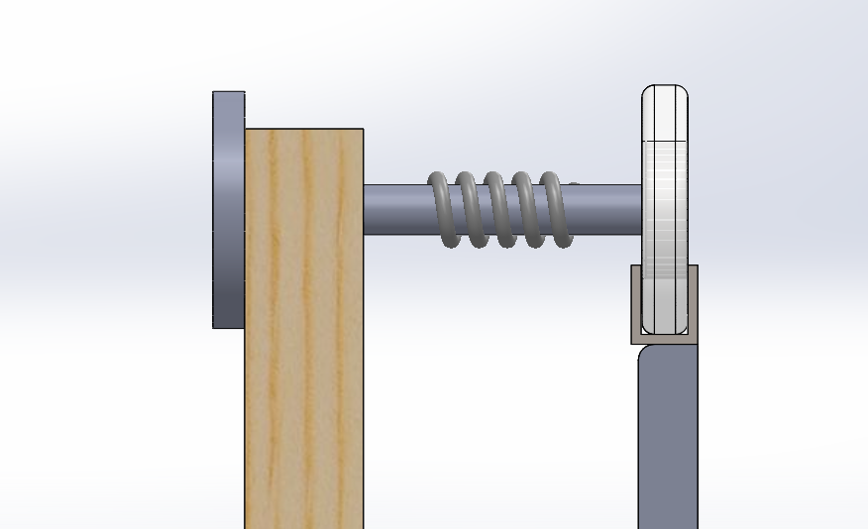
Selected Design
Shaft
Spring
Wheel
Connecting Link
Whiteboard

Slide 9
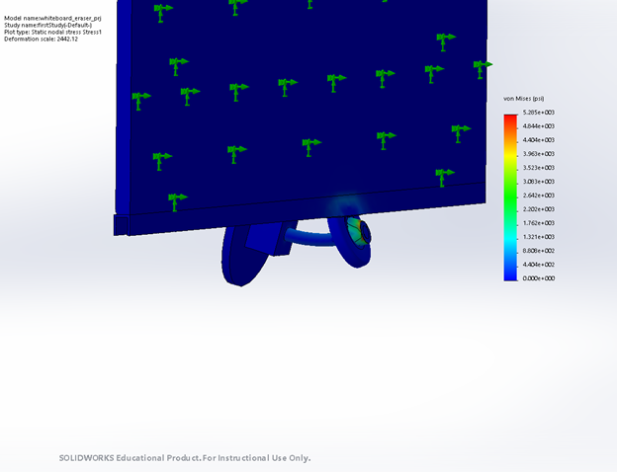
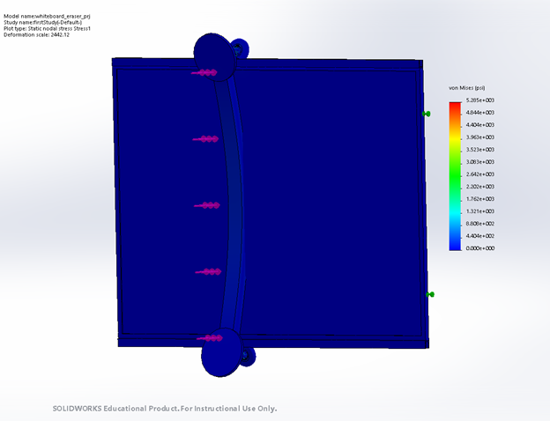
Design Analysis - Stress
Max Stress:
5.285e+003 (psi)

Slide 10
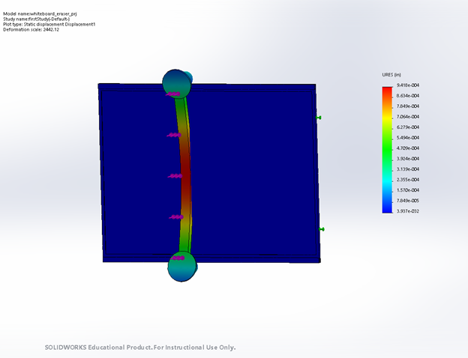
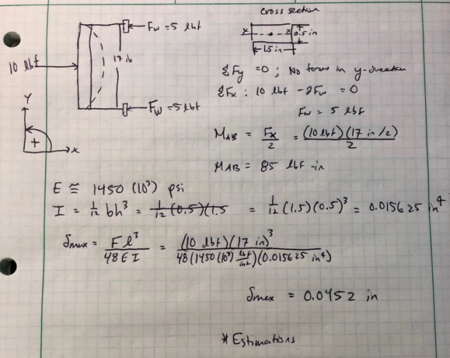
Design Analysis - Strain
Max Strain: 9.418e-004 (in)

Slide 11
Analysis of Simulation
We used the Simulation package to analyze the whole assembly
All the parts have close or similar material selections from the real model
The weak points of the assembly lay on the wheel and railing interaction
Possible improvements to reduce concentration of stress

Slide 12
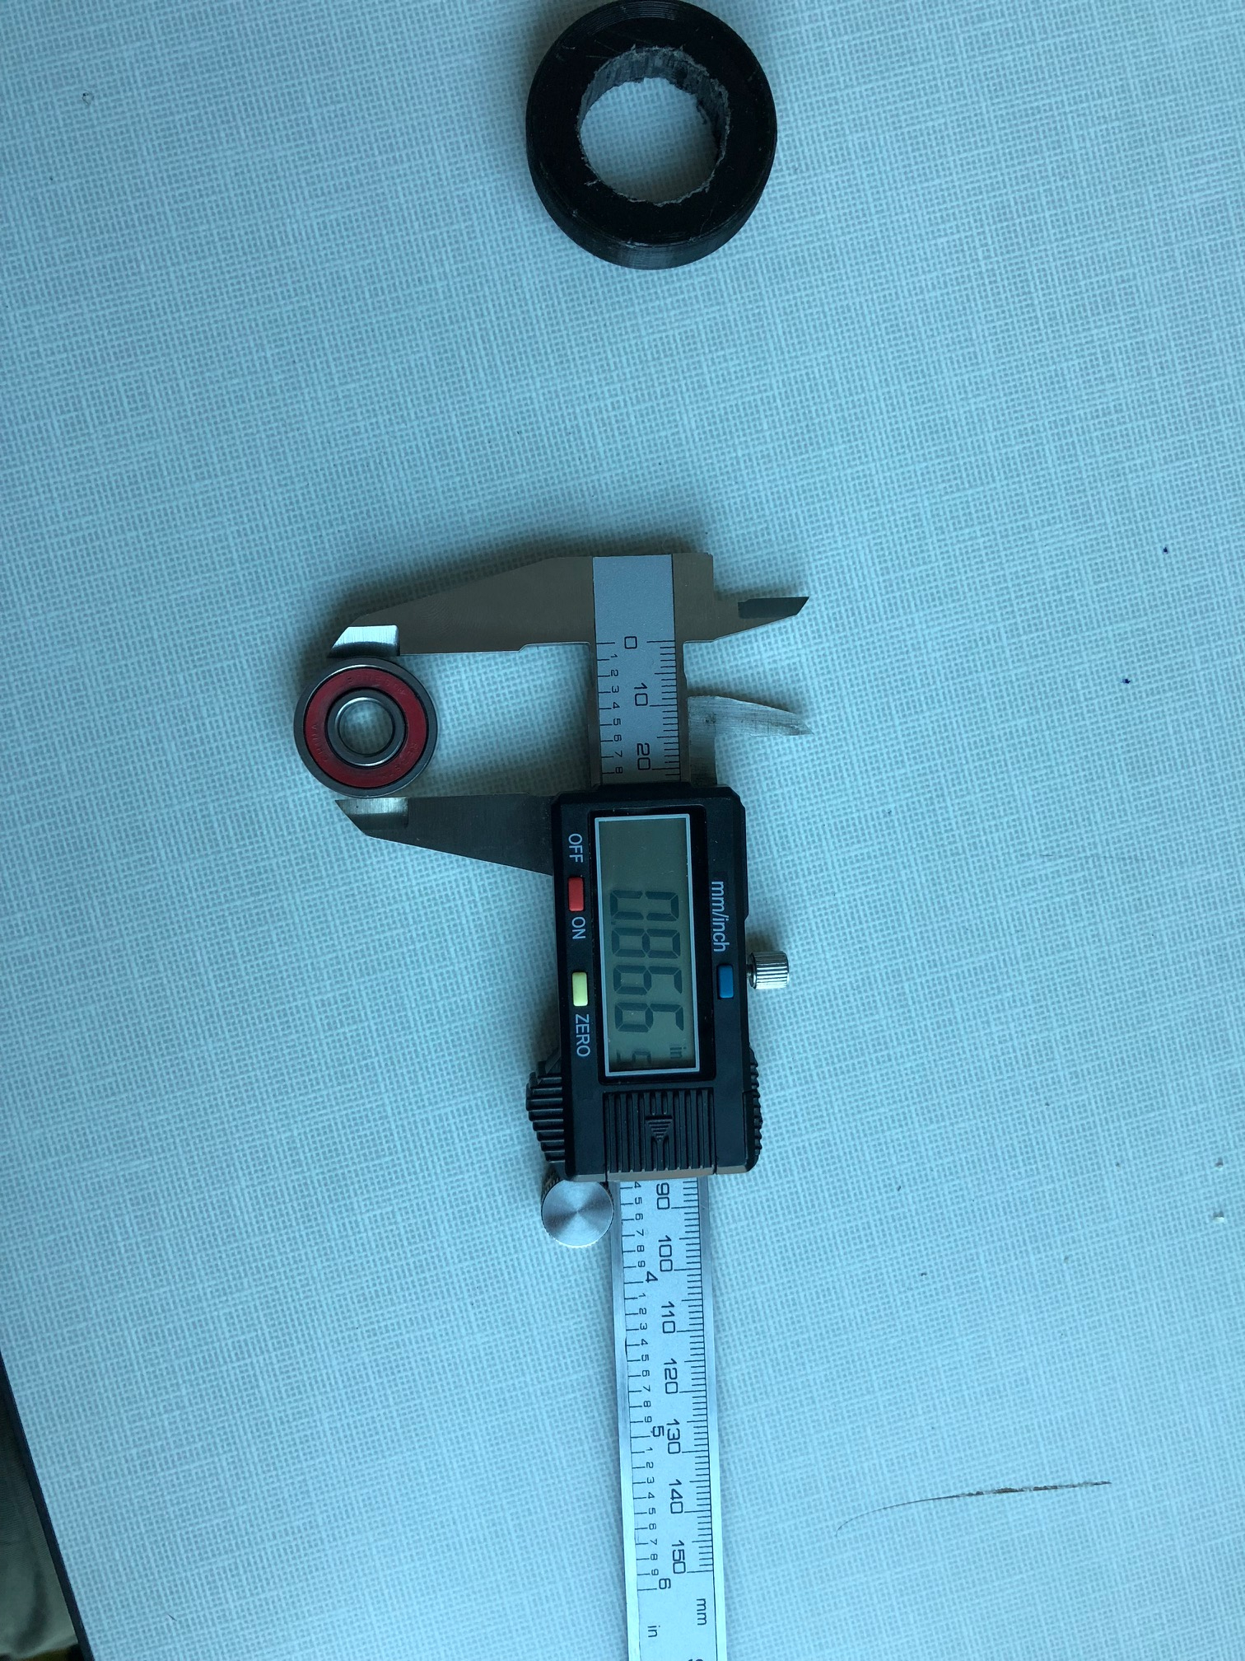
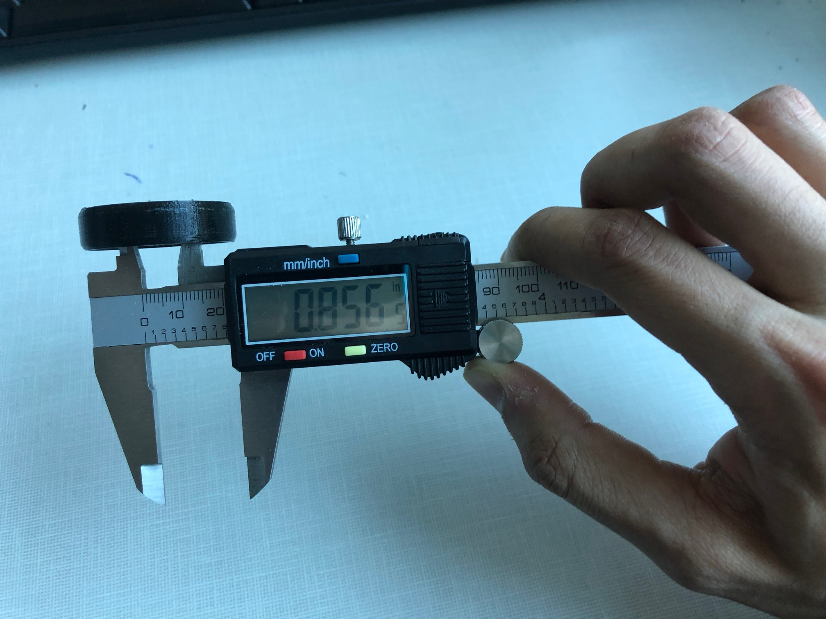
Dimensioning
Series of dimensioning methods were
used for this project.
Some of the tools used:
Vernier Calliper, Rulers, Set Square.
Tools used to customise wheel,
pins and wooden frame to
maneuver smoothly.

Slide 13
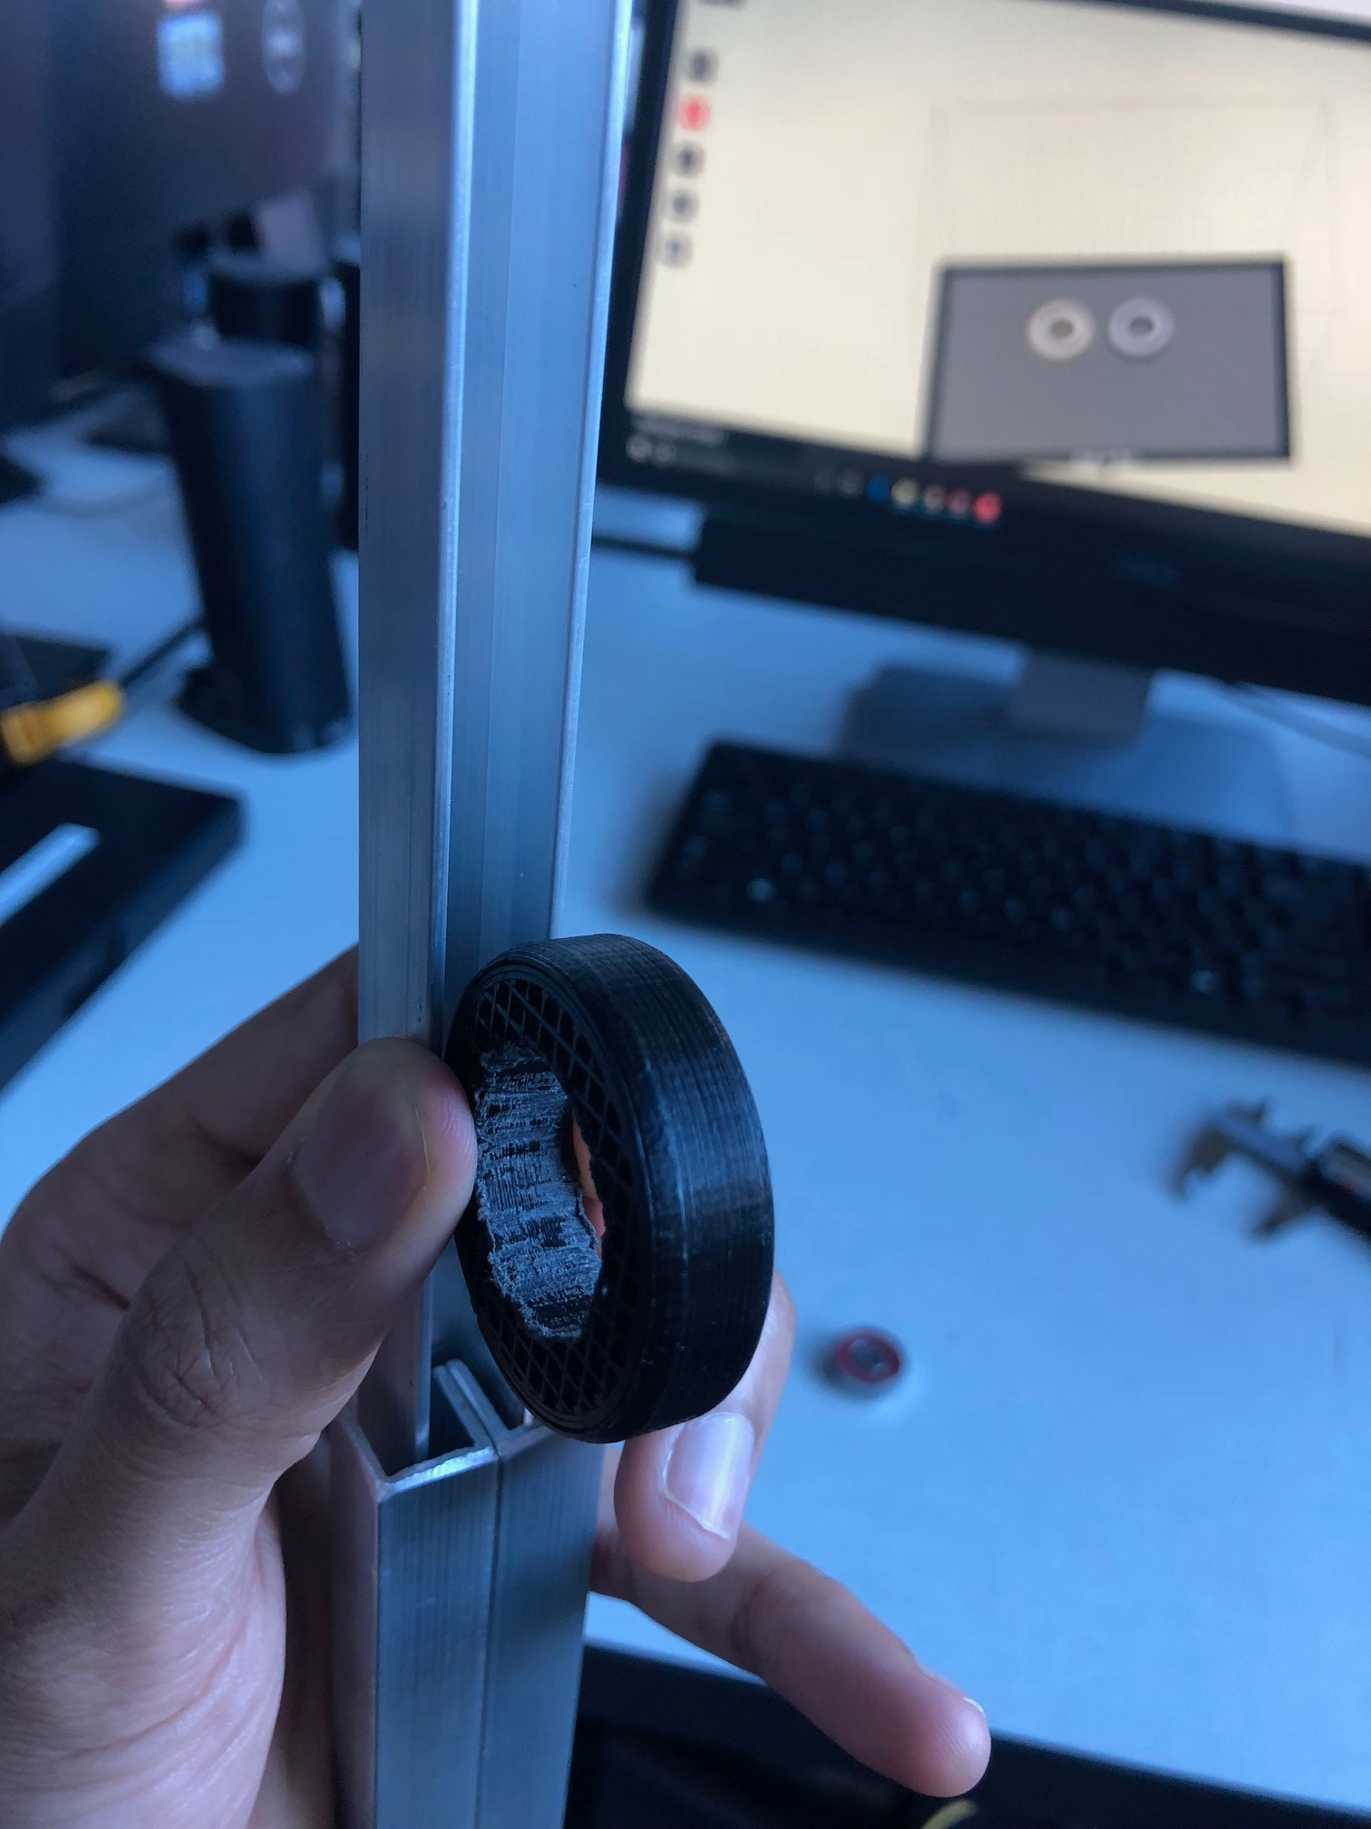
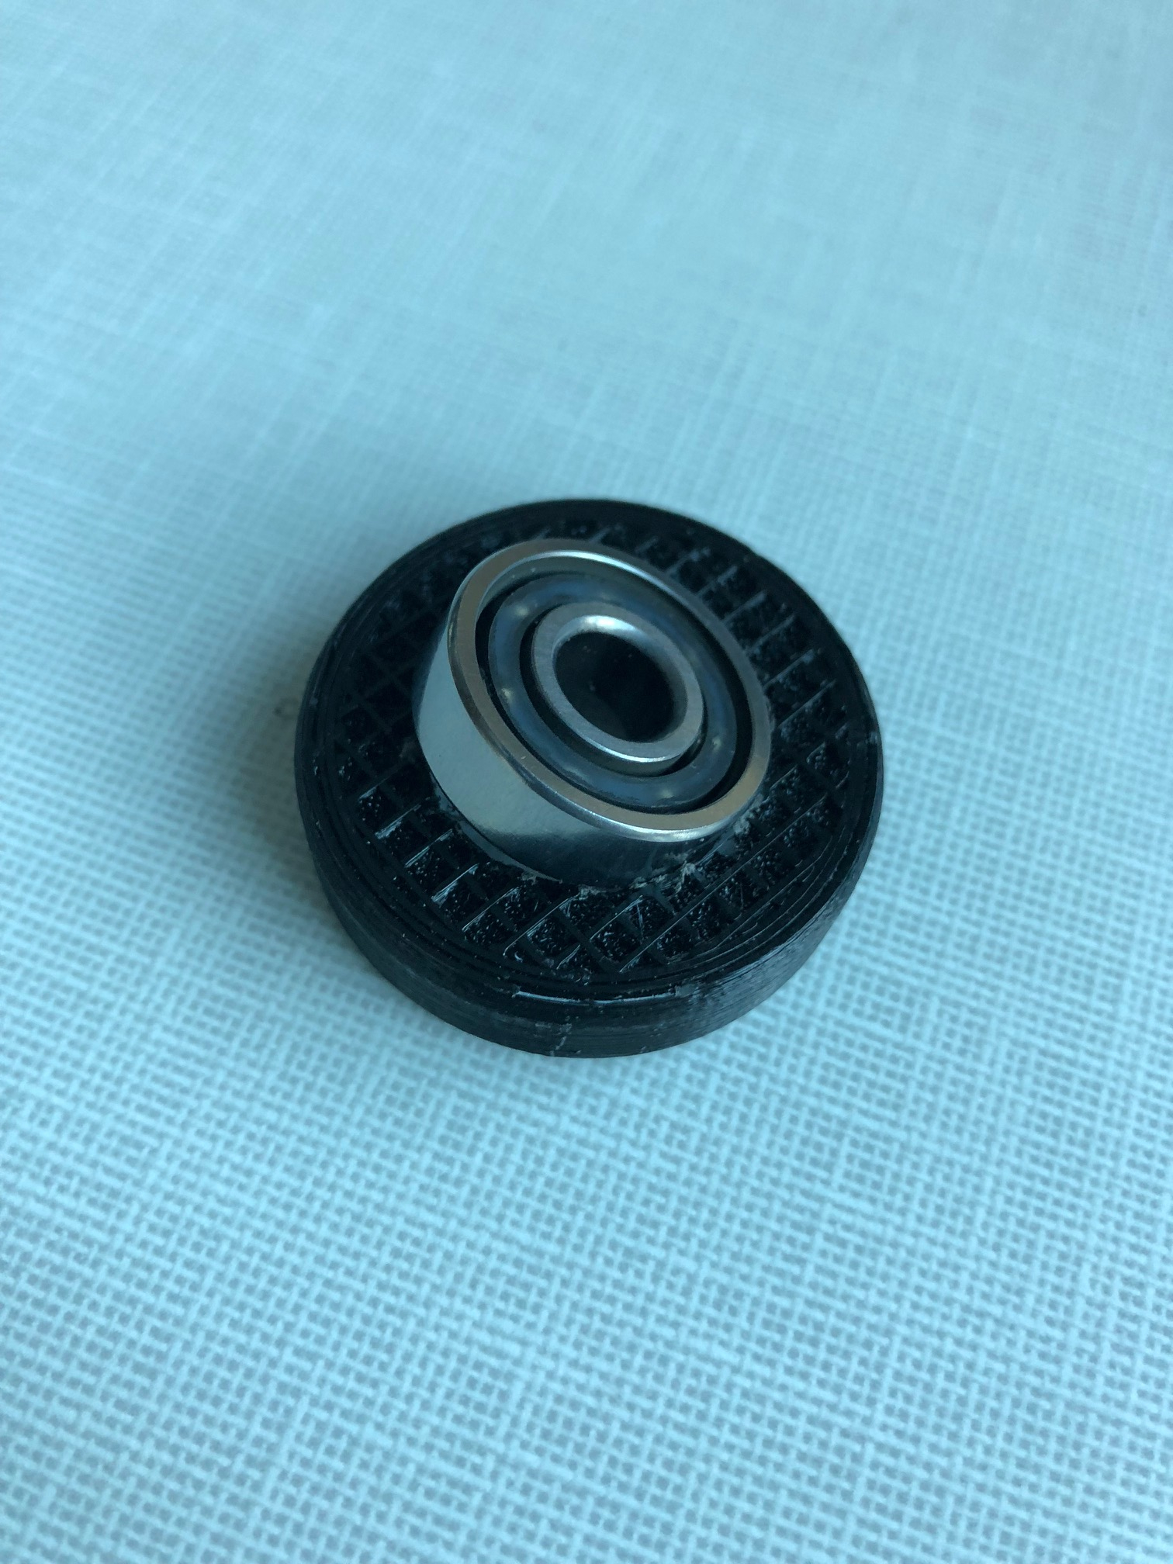
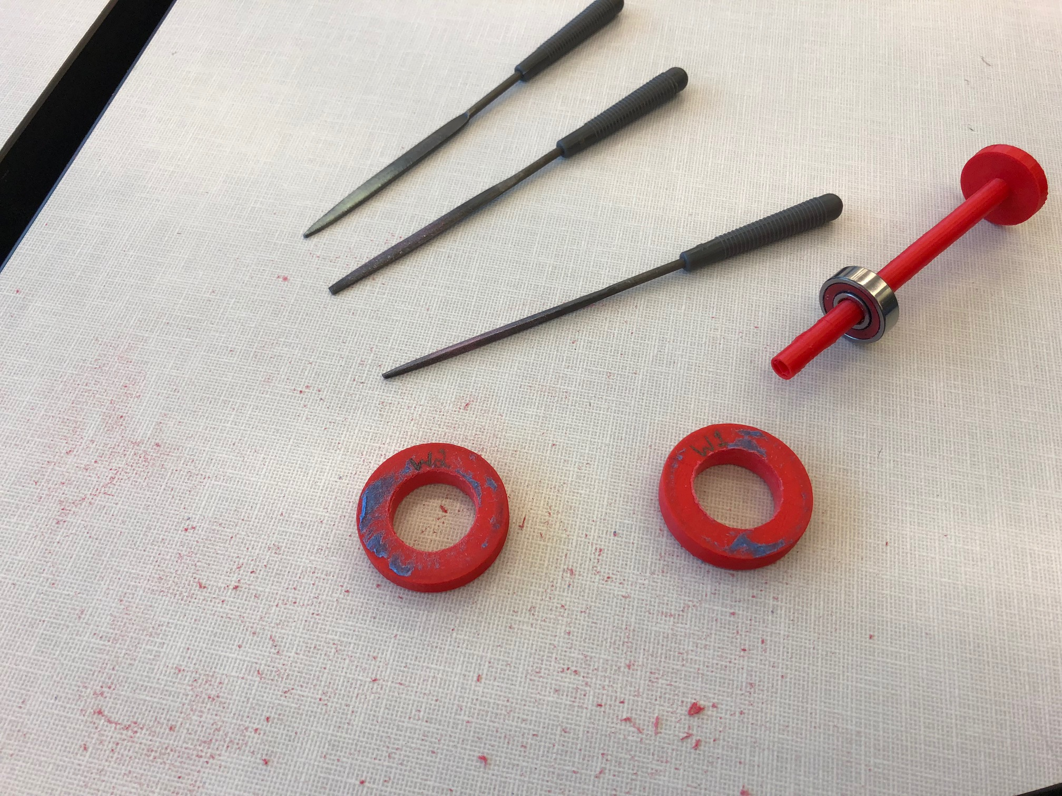
Correct Dimensioning
3D printing parts to fit the exact
dimension was a complex and
tedious task.
3D printers sometimes
shrink or overdimension parts.
Lots of trail prints and sanding
/filing is involved to finally arrive at an
approximate fit.

Slide 14
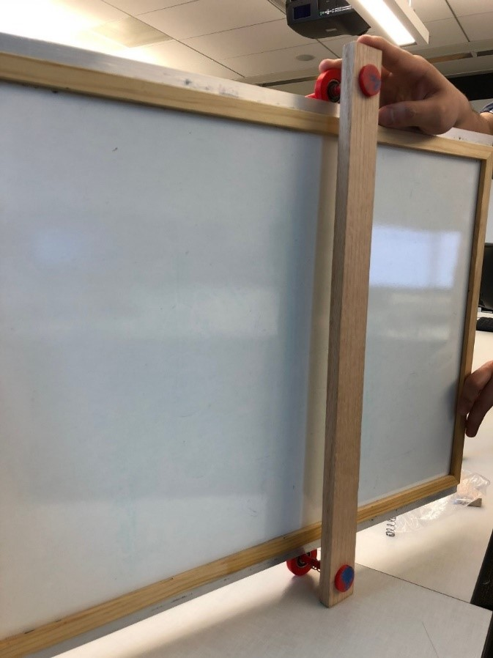
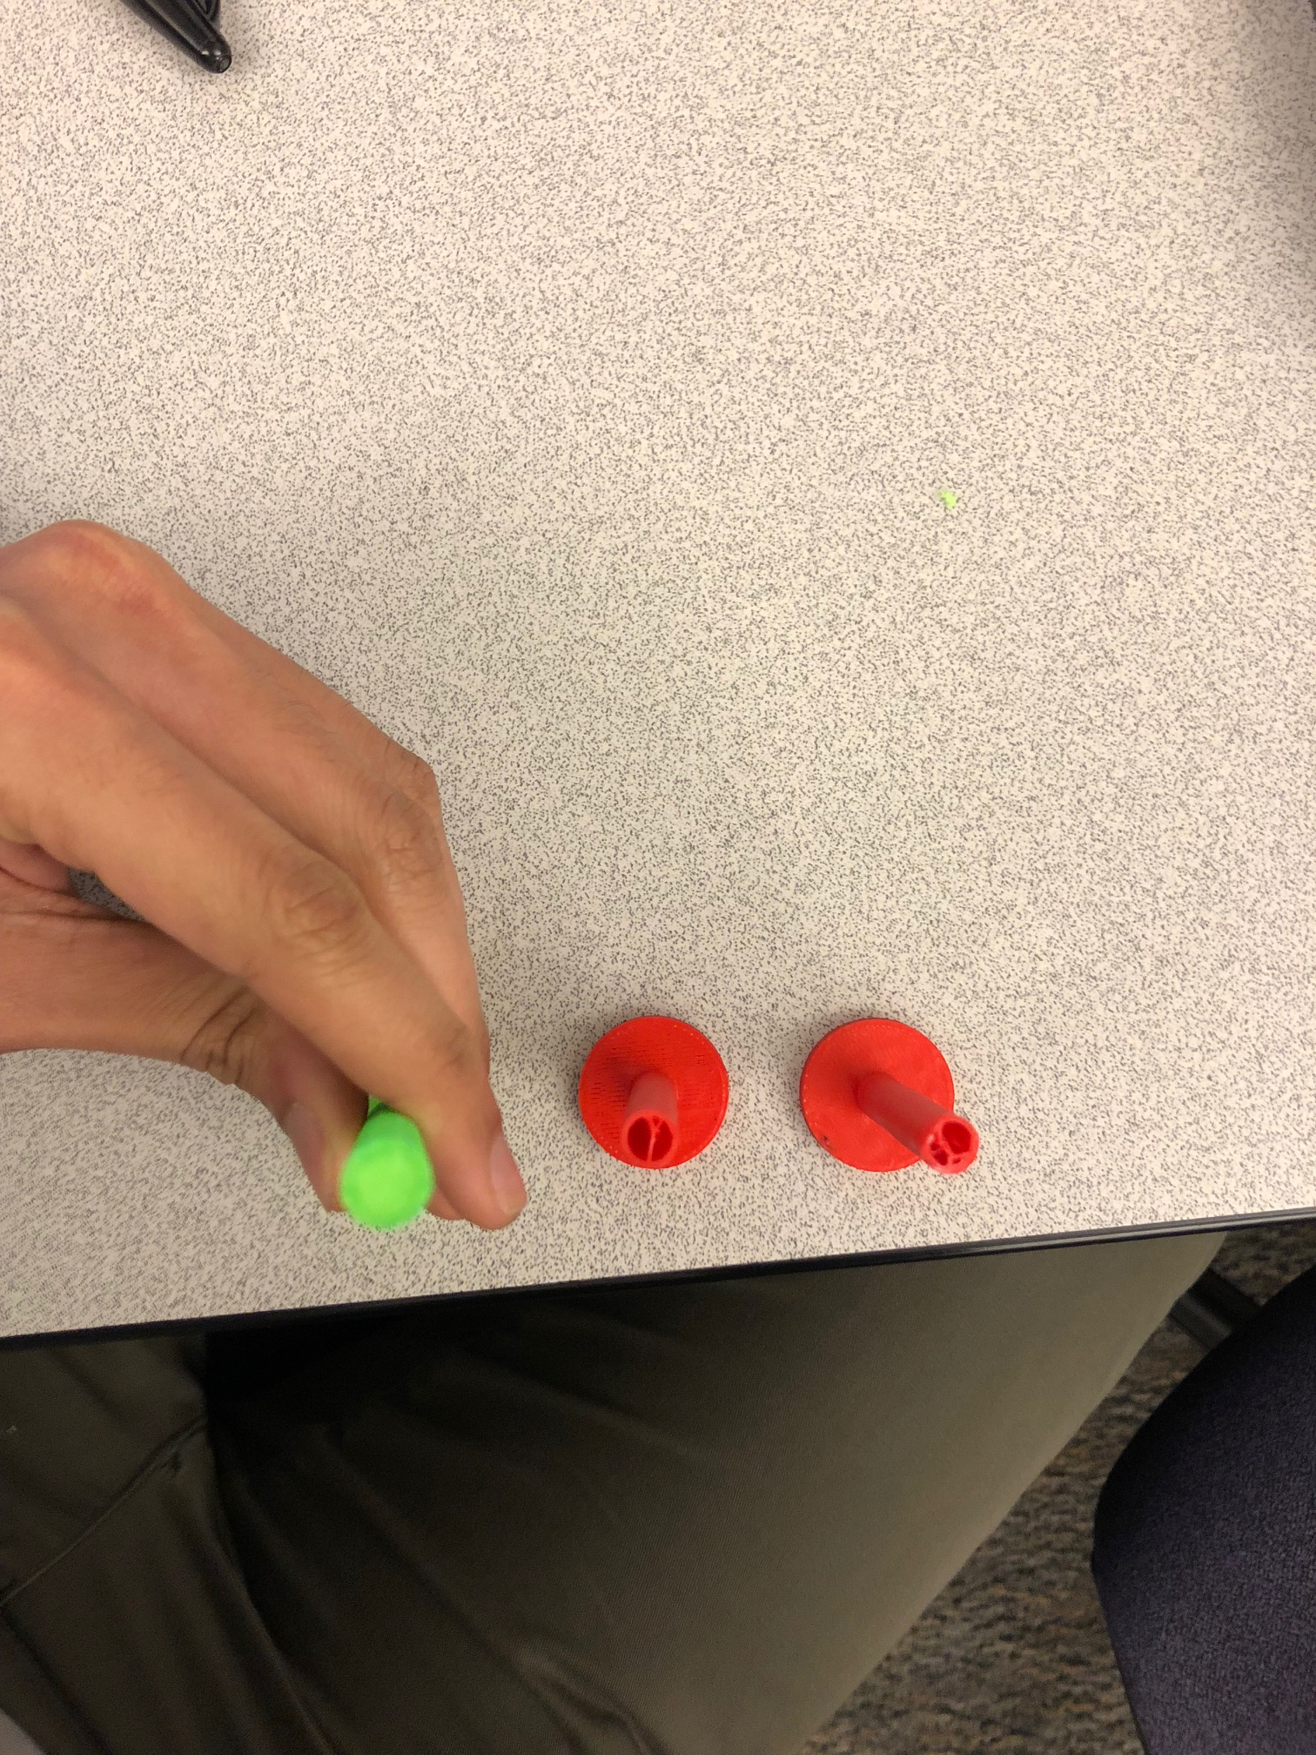
Comparison/Future Work
-Making the prints more dense.
- Implementing our design for bigger boards
-Handle for easy maneuver and ideal force application.
-Aesthetics
Cheap - $20
Mechanically simple to operate
Assembly is relatively
uninvolved

Slide 15
Summary
Identified problem
Assessed and evaluated potential solutions
Came up with a design
We built our first prototype
We design and prototype a practical and inexpensive mechanism that reduces the amount of work needed to fully erase a whiteboard.

